Slide 1
Program synthesis
2019 Autodesk summer Internship
Presenter: You-Yi Jau, M.S. in UCSD

Slide 2
Outlines
Motivation
Related work
Method overview
Discussion

Slide 3
Motivation and problem description
Motivation
Designers plot in different format: sketch, CAD/3D, BIM
Hand-crafted each stage from scratch
Hard to iteratively redesign
Problem description
Input: floorplan, output: parametrized floorplan
Prior work: rectangular assumption
Use the idea of polygon-rnn to predict general shapes
Input: floorplan, output: CAD plots
Data: paired floorplan to CAD outputs
Sketch
CAD/3D
BIM
High-level
Detailed
Notes:
However, they typ- ically perform poorly under extreme appearance changes, e.g., between day and night [71] or seasons [46], or in weakly textured scenes [59].

Slide 4
Problem formulation (temp.)
Input: Architecture 2D drawings (pixel)
output: programs (3D elements: e.g. walls, windows, doors, furniture)
Modules
Image:
2D drawing
Programs
Notes:
Elements/procedures/

Slide 5
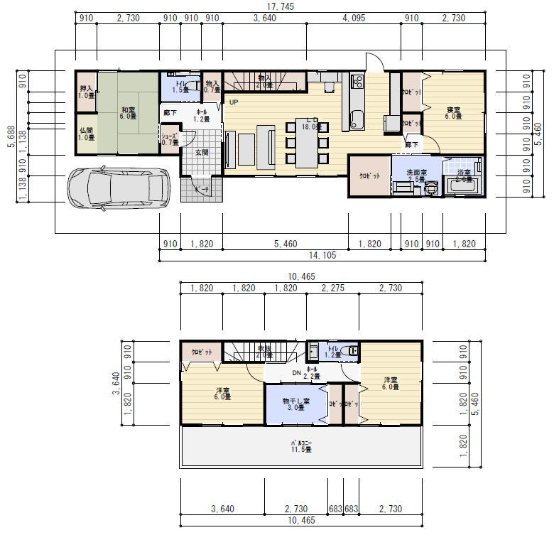
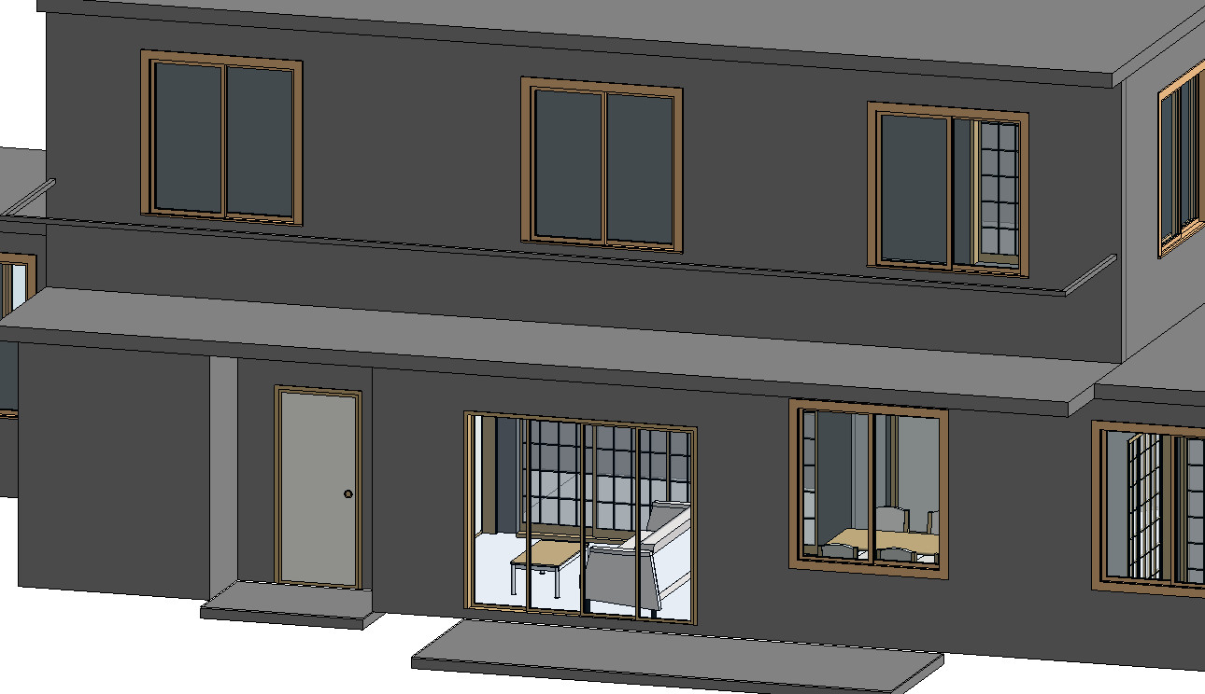
Example
Modules
Renderer
Image:
2D drawing
Programs
Shapes

Slide 6
Related work
Unsupervised Image to Sequence Translation with Canvas-Drawer Networks
K Frans, CY Cheng - arXiv preprint arXiv:1809.08340, 2018
Learning to Infer and Execute 3D Shape Programs
Y Tian, A Luo, X Sun, K Ellis, WT Freeman… - arXiv preprint arXiv …, 2019
Synthesizing programs for images using reinforced adversarial learning
Y Ganin, T Kulkarni, I Babuschkin, SM Eslami… - arXiv preprint arXiv …, 2018

Slide 7
Method overview
From previous works: encoder/ planner/ decoder
Input
Encoder
Planner
Decoder
Output
Image floorplan:
I_{t}

Slide 8
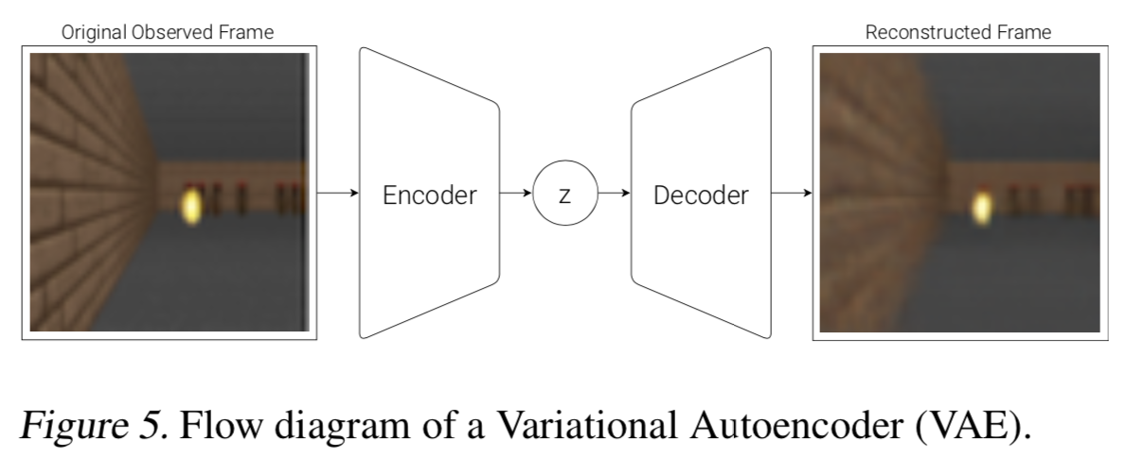
Method overview
From previous works: encoder/ planner/ decoder
Latent space
Input
Encoder
Planner
Decoder
Output
Conv, VAE
World Model

Slide 9
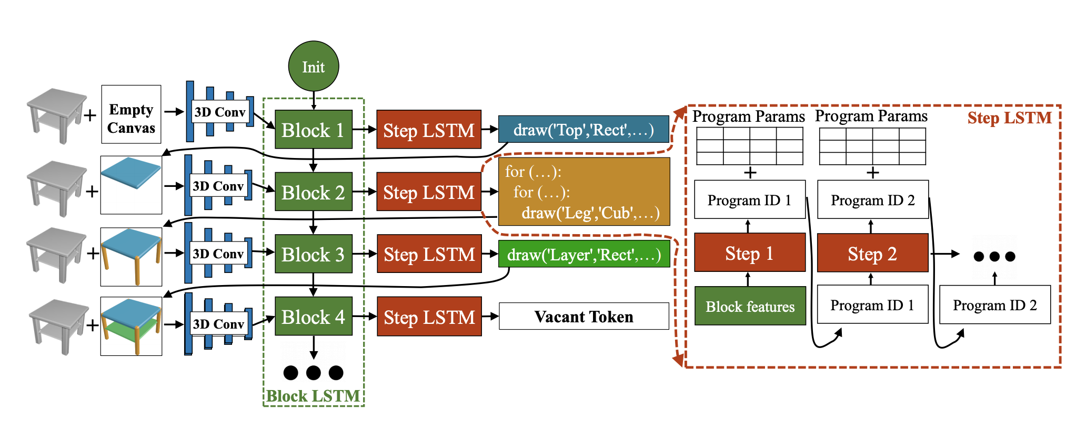
Method overview
From previous works: encoder/ planner/ decoder
Change domain
actions
Input
Encoder
Planner
Decoder
Output
LSTM
Learning to Infer and Execute 3D Shape Programs
Notes:
vertex
Heatmap

Slide 10
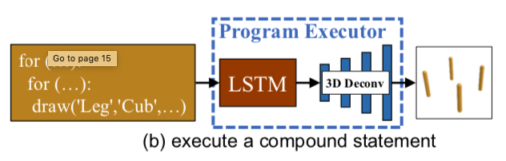
Method overview
From previous works: encoder/ planner/ decoder
Plot actions
Differentiable
Mathematical renderer
Input
Encoder
Planner
Decoder
Output
Renderer
Learning to Infer and Execute 3D Shape Programs

Slide 11
Method overview
From previous works: encoder/ planner/ decoder
3D shapes
Avoid voxels, point clouds
Change to 2D Representation
Input
Encoder
Planner
Decoder
Output
CAD plots
Learning to Infer and Execute 3D Shape Programs

Slide 12
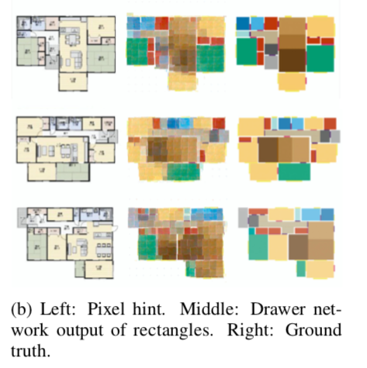
Discussion
What is the output representation?
segmentation patches?
3D shapes?
What is the loss?
pixel-wise loss
Discriminator
How to model general shapes?
Rectangle → polygon

Slide 13
Useful tools
GAN
Unpaired data: cycle GAN
Shared latent representation: Multimodal unsupervised image-to-image translation (MUNIT GAN)
RL
Latent space planning and imagination: World Model
Reward-based training
Synthesizing Programs for Images using Reinforced Adversarial Learning
Efficient interactive annotation of segmentation datasets with polygon-rnn++

Slide 14
Others
Semantic segmentation
Polygon RNN
Curve-GCN
Multi-view synthesis
handle the 3D shapes
Graph
model the relationships between objects

Slide 15
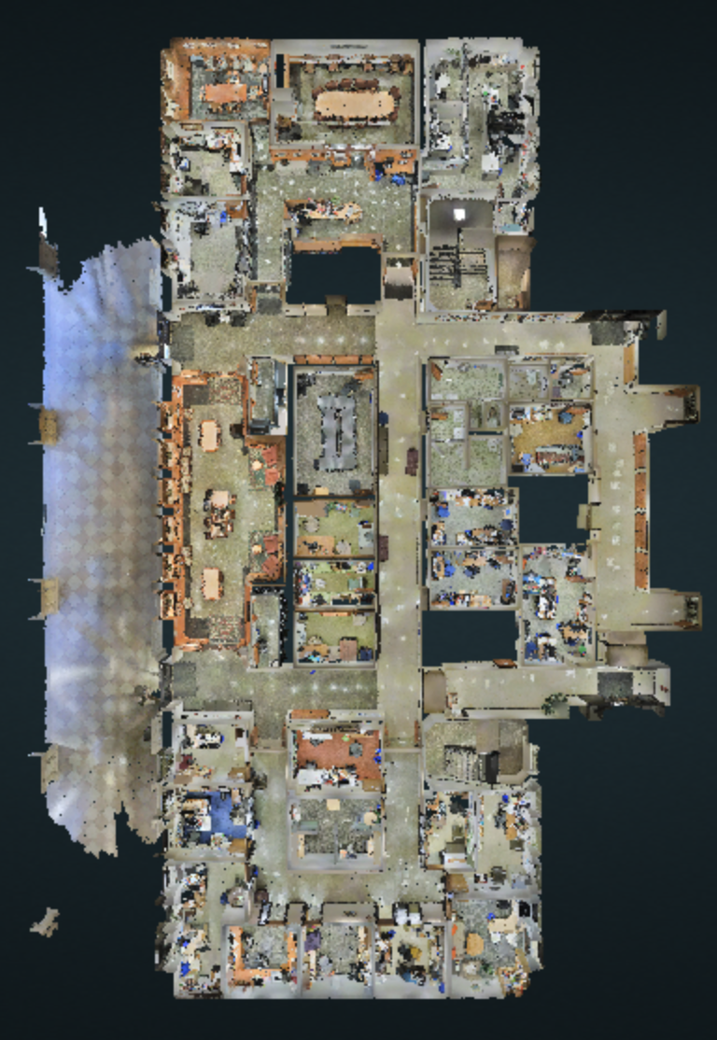
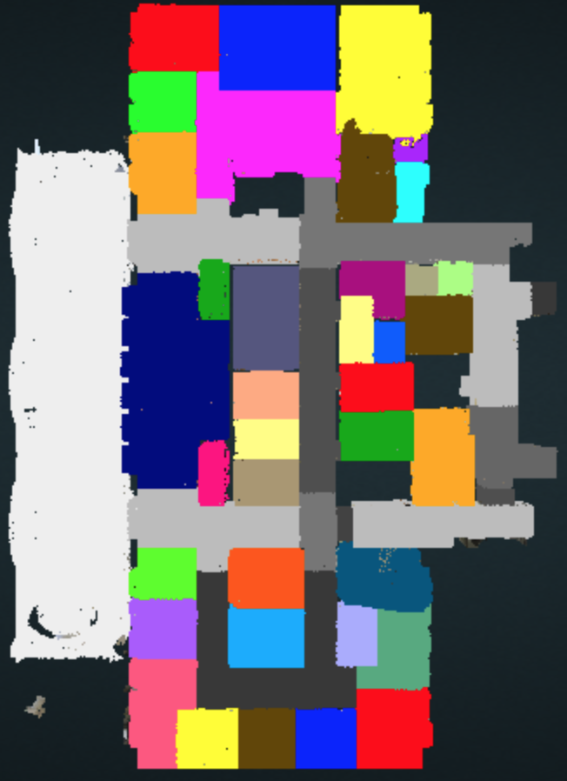
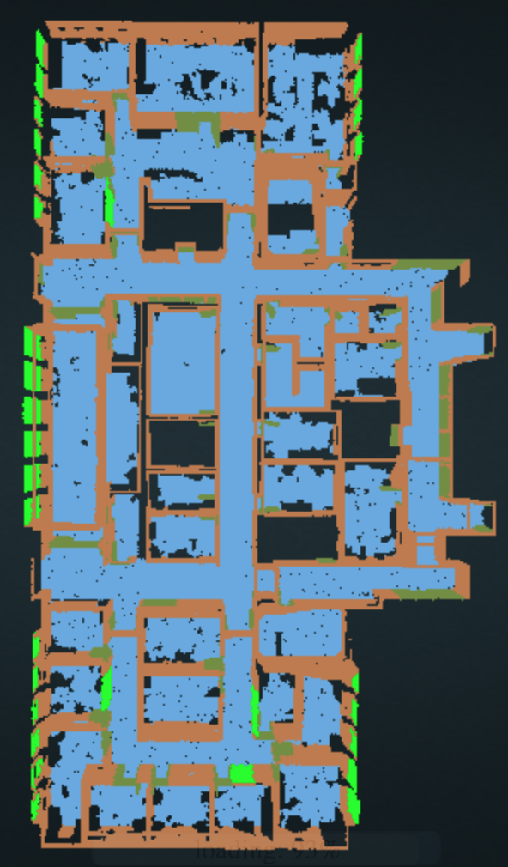
Datasets
2D-3D-S Large Scale Parsing

Slide 16
注文住宅 間取り集 間取り作成 無料

Slide 17
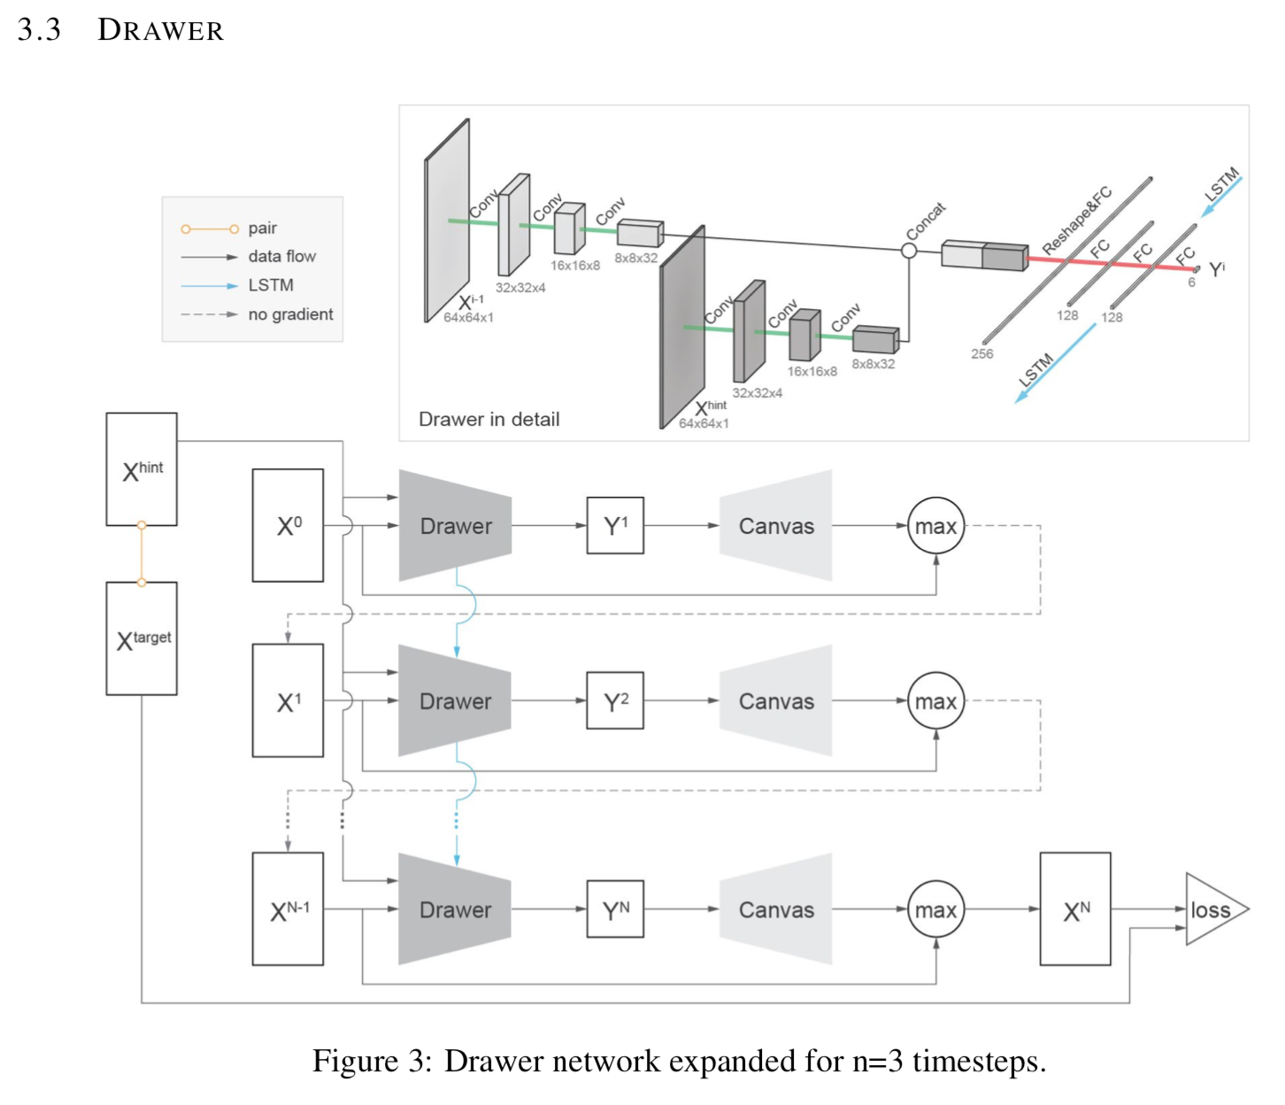
Input: floorplan, output: parametrized floorplan
Baseline
Loss: pixel-wise at output
Unsupervised: no corresponding programs
Problem
rectangle assumption
Look similar, but different shapes
too many shapes (add constraints)

Slide 18
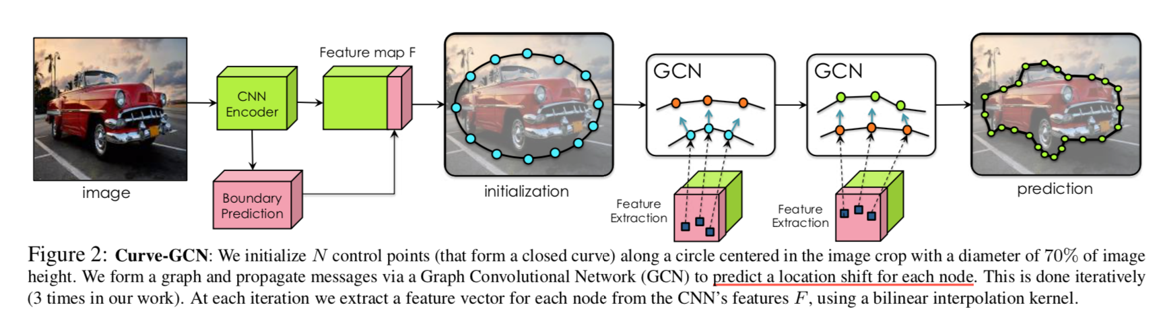
Our method
Constraints
predict polygons
One category: room, wall
Encourage connectivity
Recurrently predict vertices

Slide 19
Our method
Details
pipeline
Dataset
metrics

Slide 20
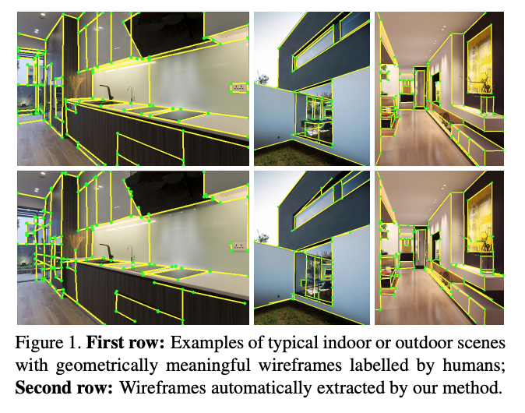
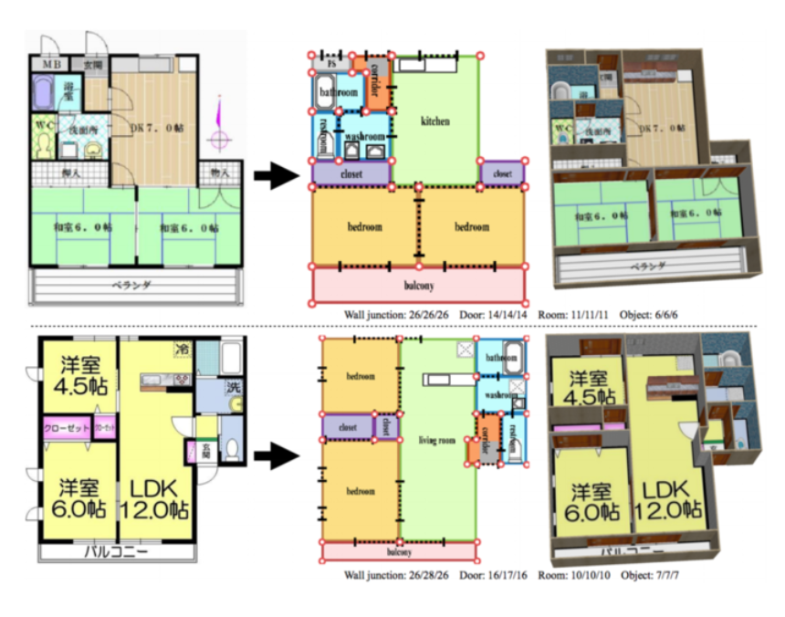
Input: floorplan, output: parametrized floorplan
Input: floor plan
Output: walls/ doors (lines)
Ref:
Learning to Parse Wireframes in Images of Man-Made Environments
K Huang, Y Wang, Z Zhou, T Ding, S Gao, Y Ma - Proceedings of the IEEE …, 2018
Raster-to-vector: Revisiting floorplan transformation
C Liu, J Wu, P Kohli, Y Furukawa - Proceedings of the IEEE International Conference …, 2017

Slide 21
Thank you

Slide 22
Backup

Slide 23
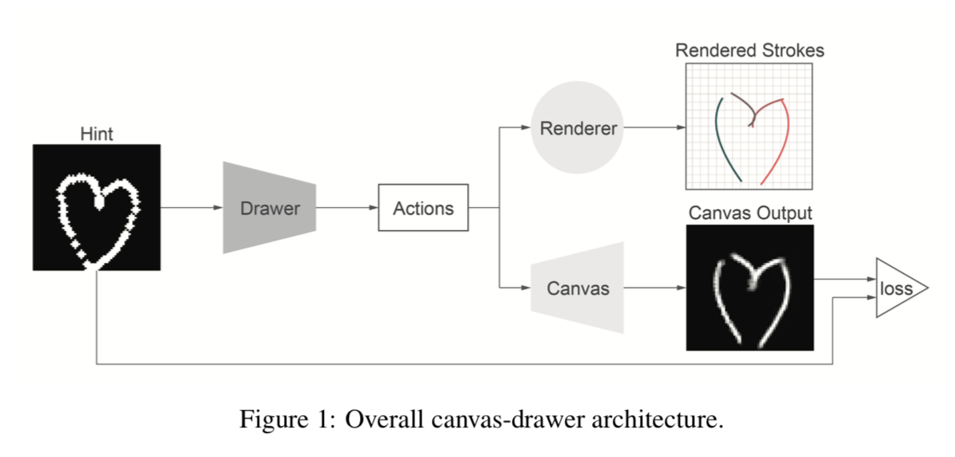
Unsupervised Image to Sequence Translation with Canvas-Drawer Networks
Unsupervised manner
Canvas-Drawer Networks
Canvas: CNN layers
Drawer: RNN structure
Unsupervised Image to Sequence Translation with Canvas-Drawer Networks
K Frans, CY Cheng - arXiv preprint arXiv:1809.08340, 2018
Notes:
2D case, work on 3D case
What for
We present a method for generating images directly in a high-level domain (e.g. brush strokes), without the need for real pairwise data.
What is trained
canvas-drawer structure
Image pair: hint image could be coarse compared to target image.
loss: pixel different of output and targeted image

Slide 24
Learning to Infer and Execute 3D Shape Programs
Transform point clouds into shape programs
generator - executor structure
generator: 3D conv + double LSTMs
executor: LSTM + 3D deconv.
Learning to Infer and Execute 3D Shape Programs
Y Tian, A Luo, X Sun, K Ellis, WT Freeman… - arXiv preprint arXiv …, 2019
Notes:
What for
Transform point cloud into shape programs
What is trained
generator - executor structure
double LSTM in generator
Training (initializing) on synthetic data
Self-supervised manner, using generator to generate programs. Then, we use executor to generate shapes. The generated shape can have loss (binary cross entropy) wrt the input.
The action space is fixed. The model generate a policy on the selection of programs.

Slide 25
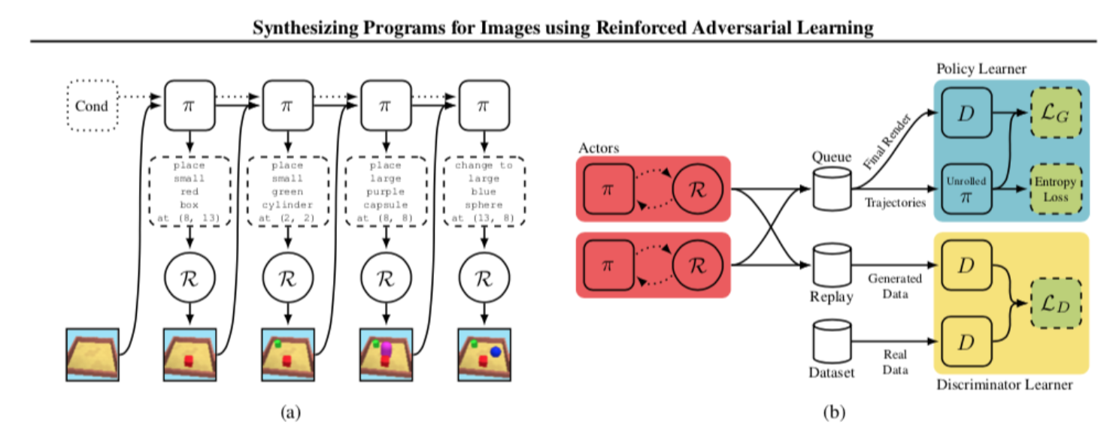
Synthesizing programs for images using reinforced adversarial learning
GAN structure
Actor, policy learner, discriminator learner
Synthesizing programs for images using reinforced adversarial learning
Y Ganin, T Kulkarni, I Babuschkin, SM Eslami… - arXiv preprint arXiv …, 2018

Slide 26
Others
Reinforcement learning (RL)
Select actions to maximize reward
Latent space/ imagination: World Model
World models
D Ha, J Schmidhuber - arXiv preprint arXiv:1803.10122, 2018
Notes:
Why it is important for imagination?
we imagine how to draw the object
we understand high level idea of the shape
we also understand low level detail of the shape

Slide 27
Working plan
April-May | June | July-August | September
Literature review | Pipeline design/ Baseline | Verify/ revise hypothesis | Experiment/ Paper writing
Survey - depth: 2D-3D problem - Breath: tools and ideas in RL, GAN | Select baseline work. Design our pipeline. Specify contributions. | Implement baseline. Connect modules as a whole. | Run experiments. Compare to state-of-the-arts and baseline quantitatively and qualitatively

